Slide 1


Software Engineering Project
Bikesh Pandey, Dustin Hemard, William Sobol, Sidhant Mahat, & Abdoul Aziz Seck

Slide 2
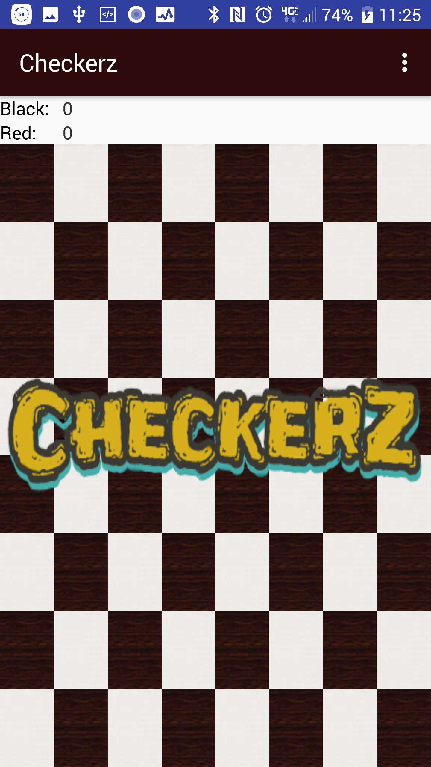
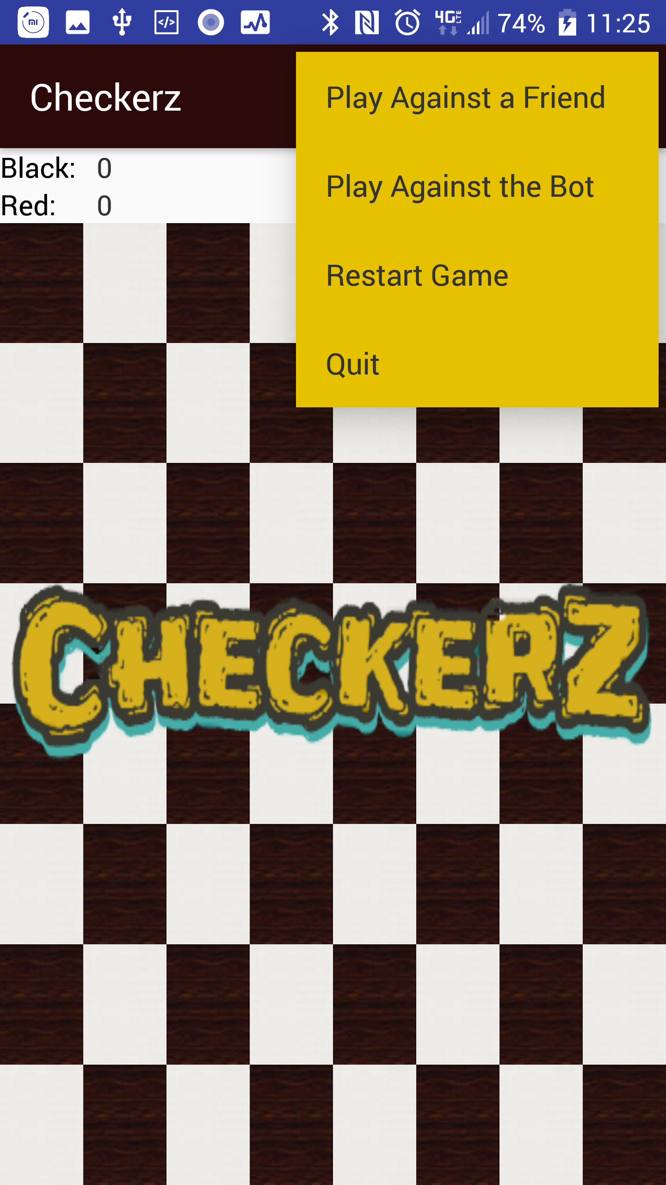
Starting up the Game

Slide 3
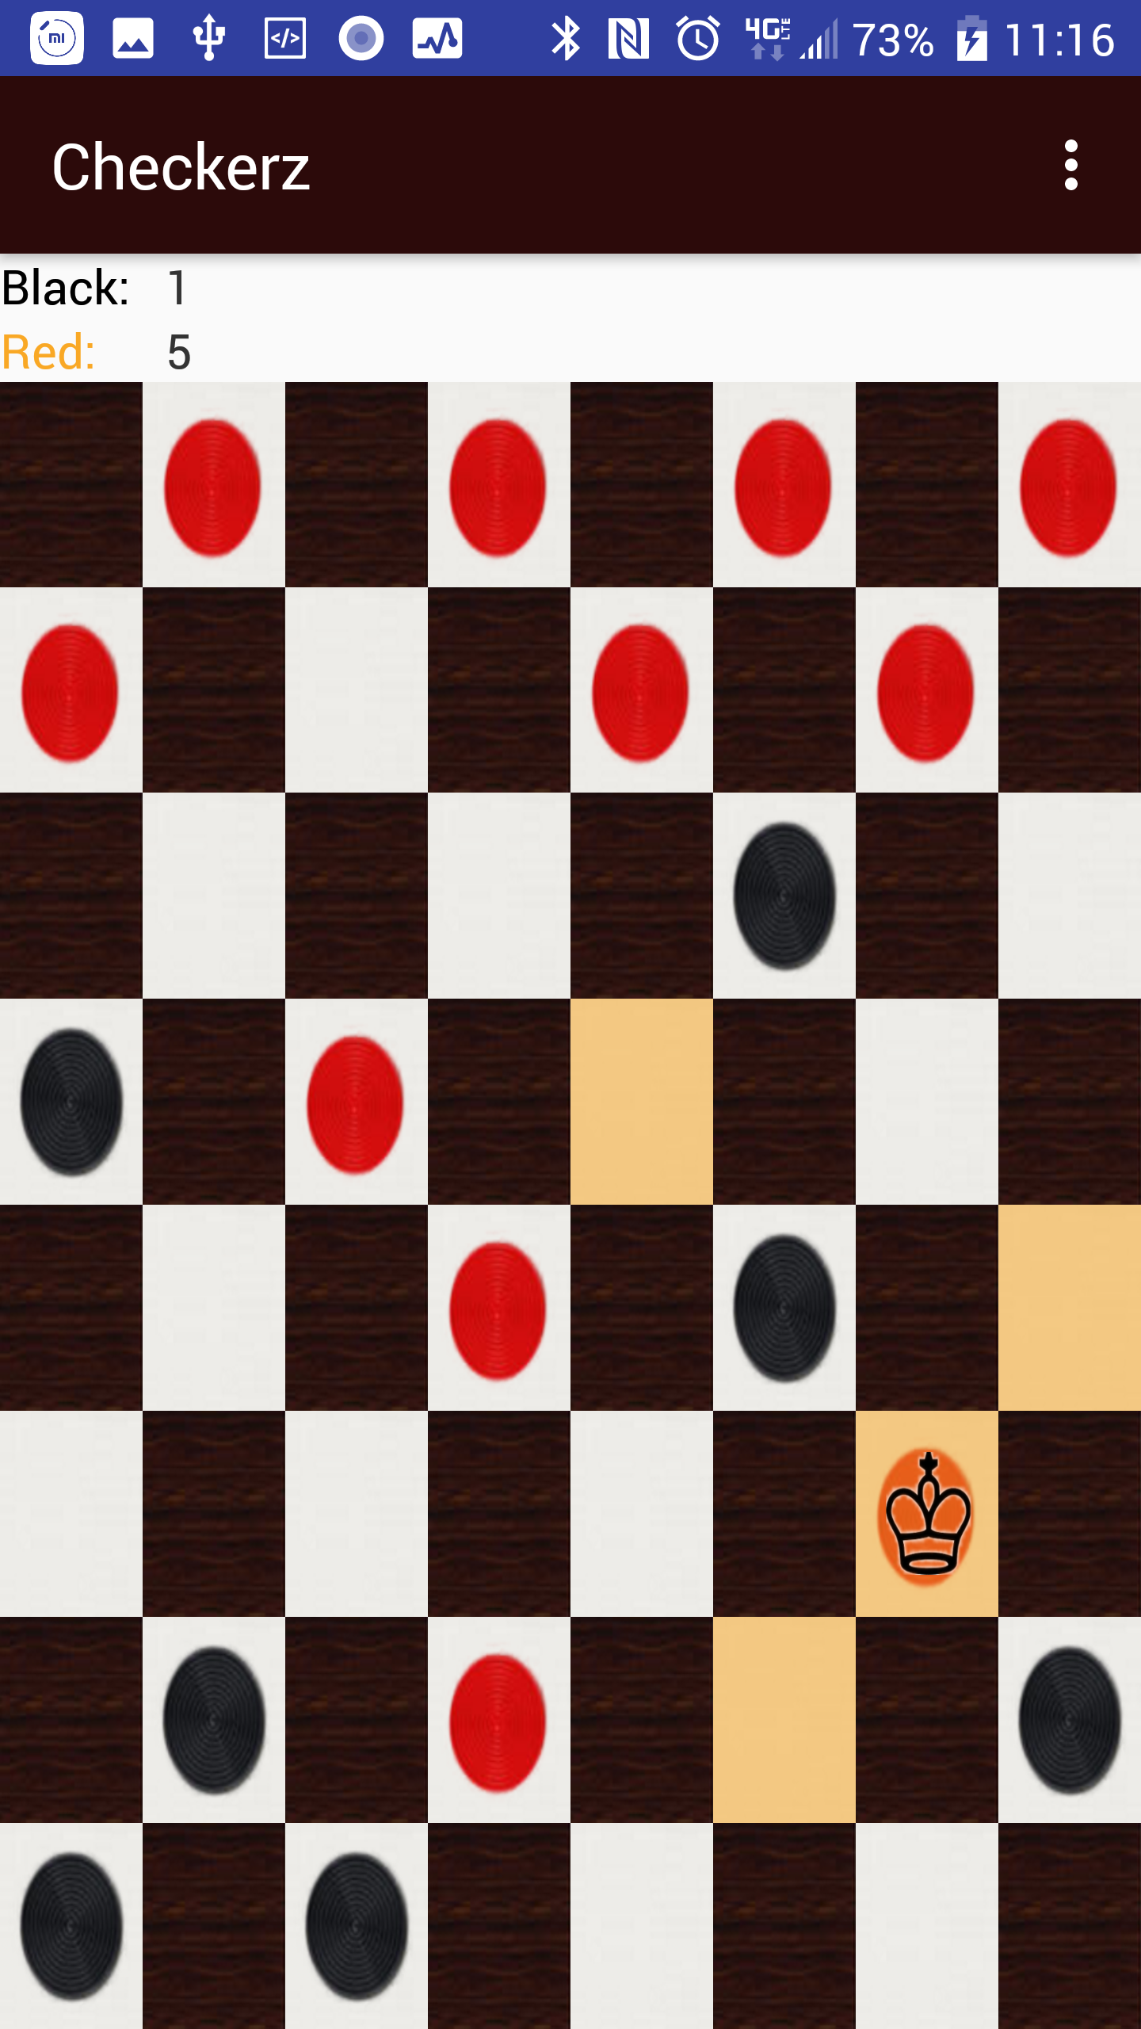
King Movement

Slide 4
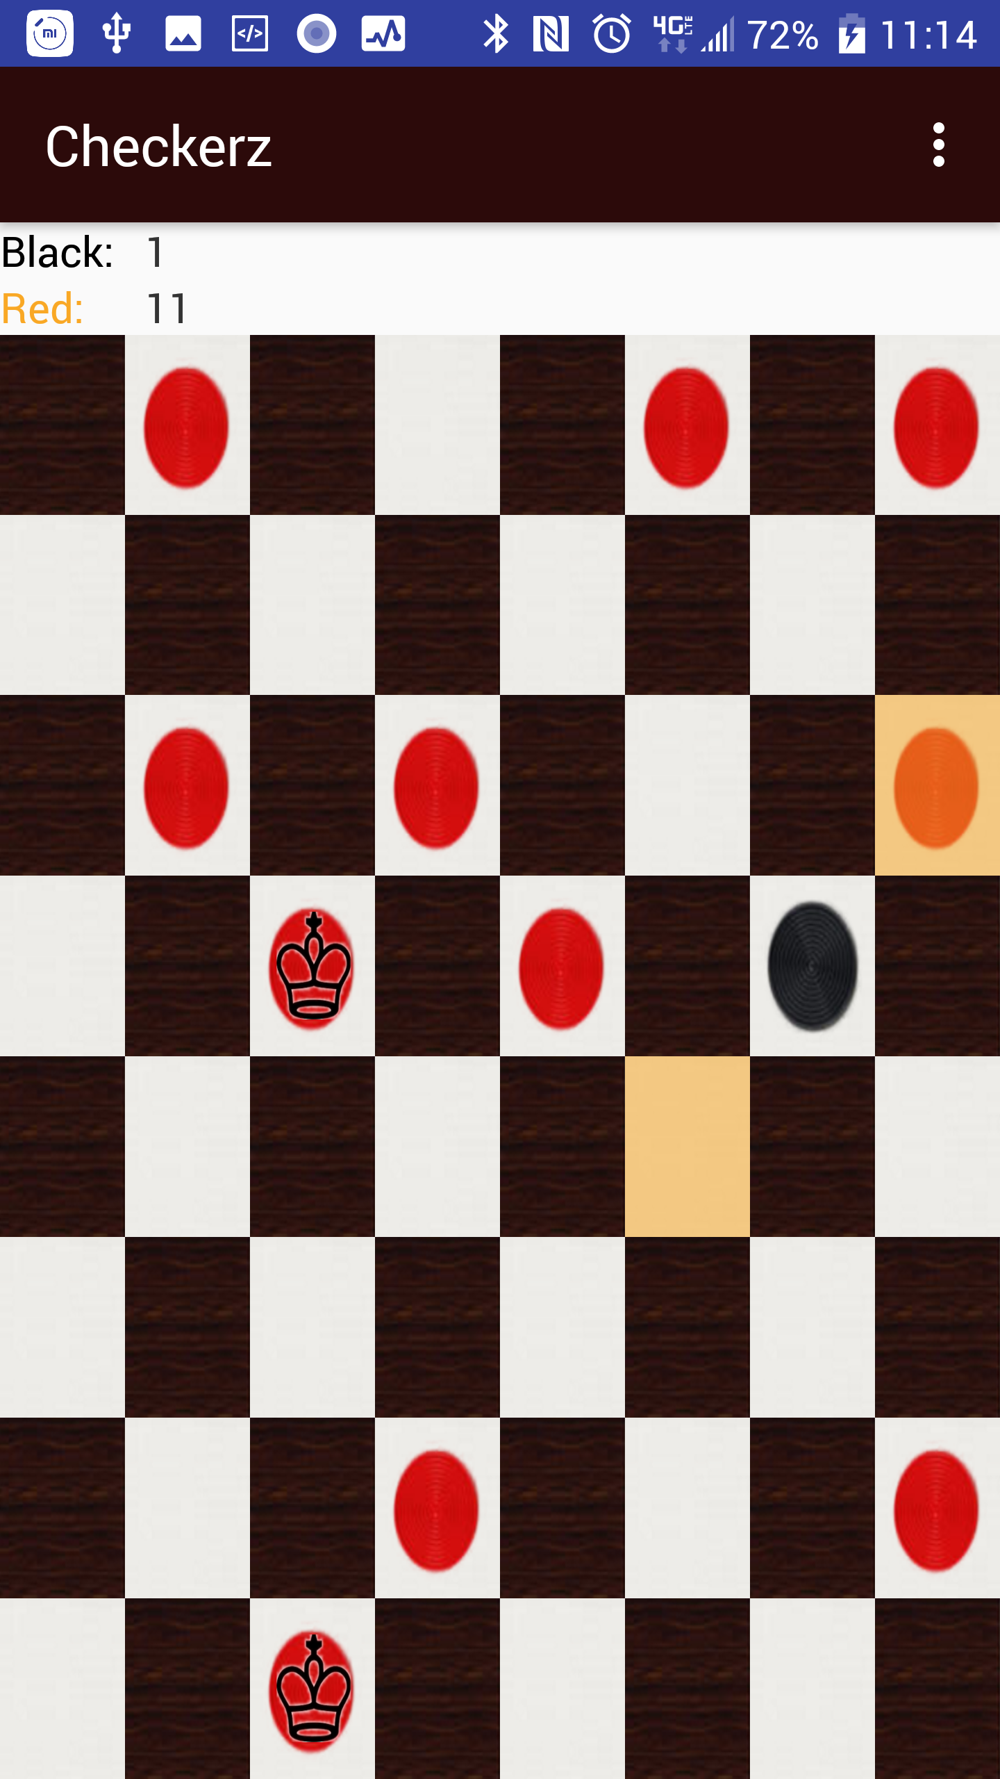
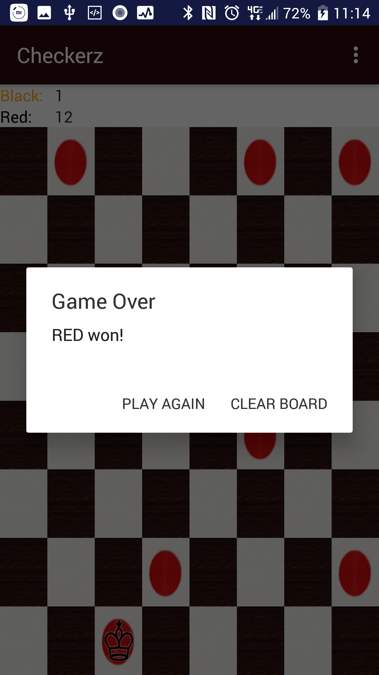
Win Condition 1

Slide 5
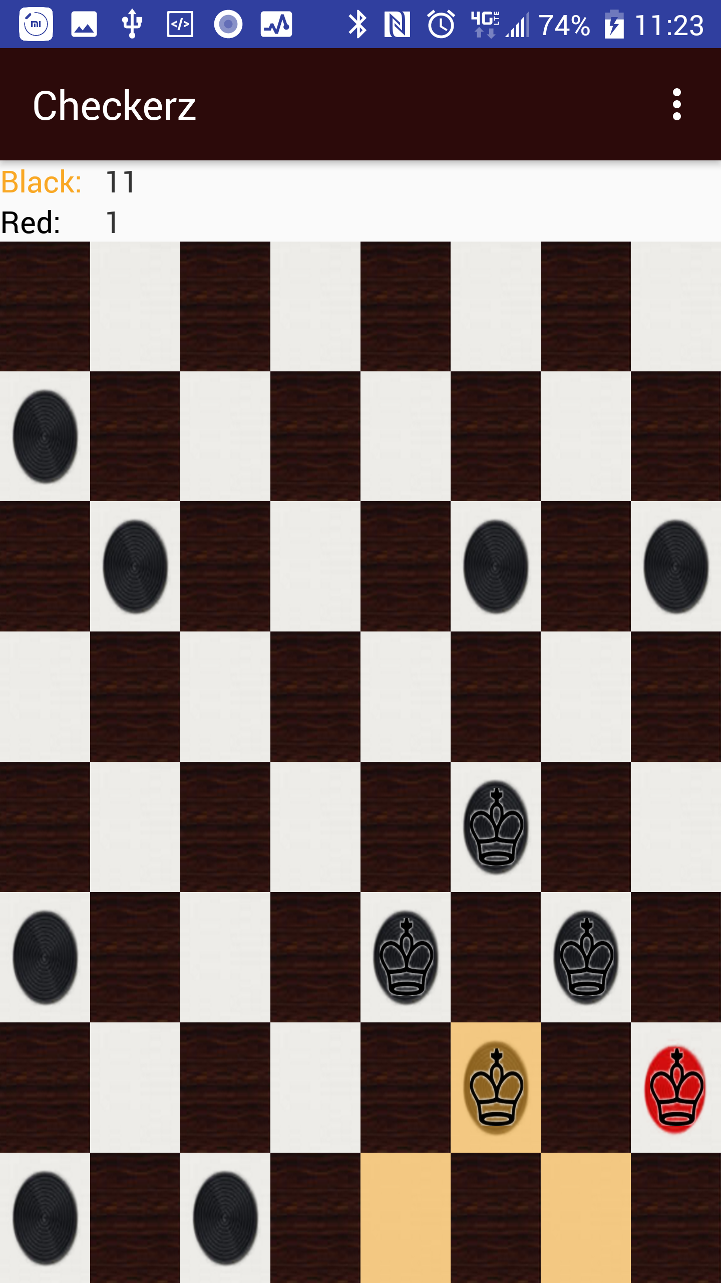
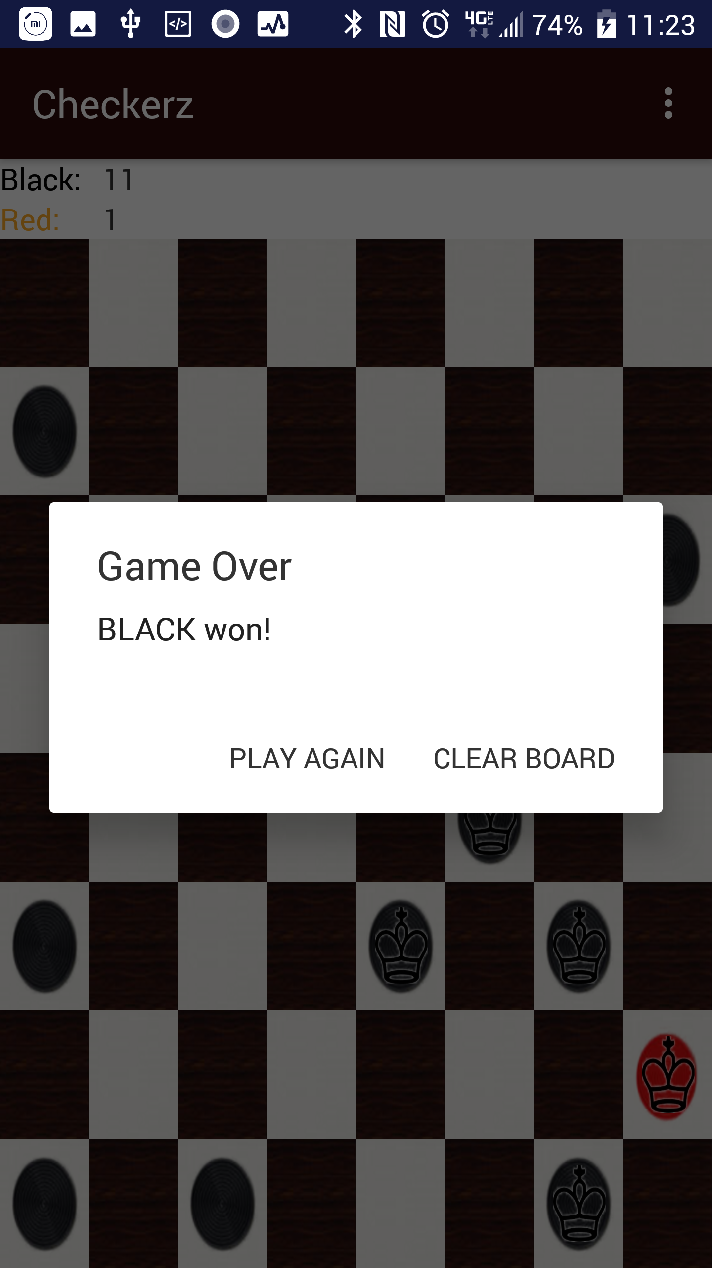
Win Condition 2

Slide 6
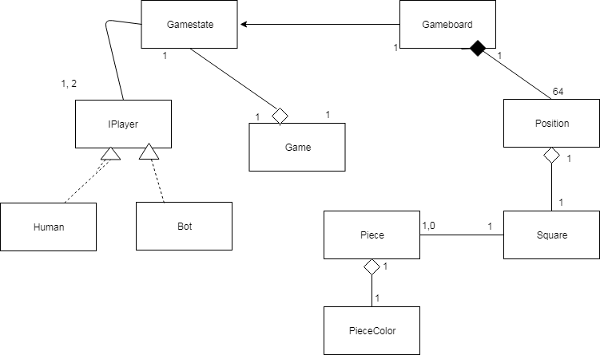
Domain Class Diagram

Slide 7
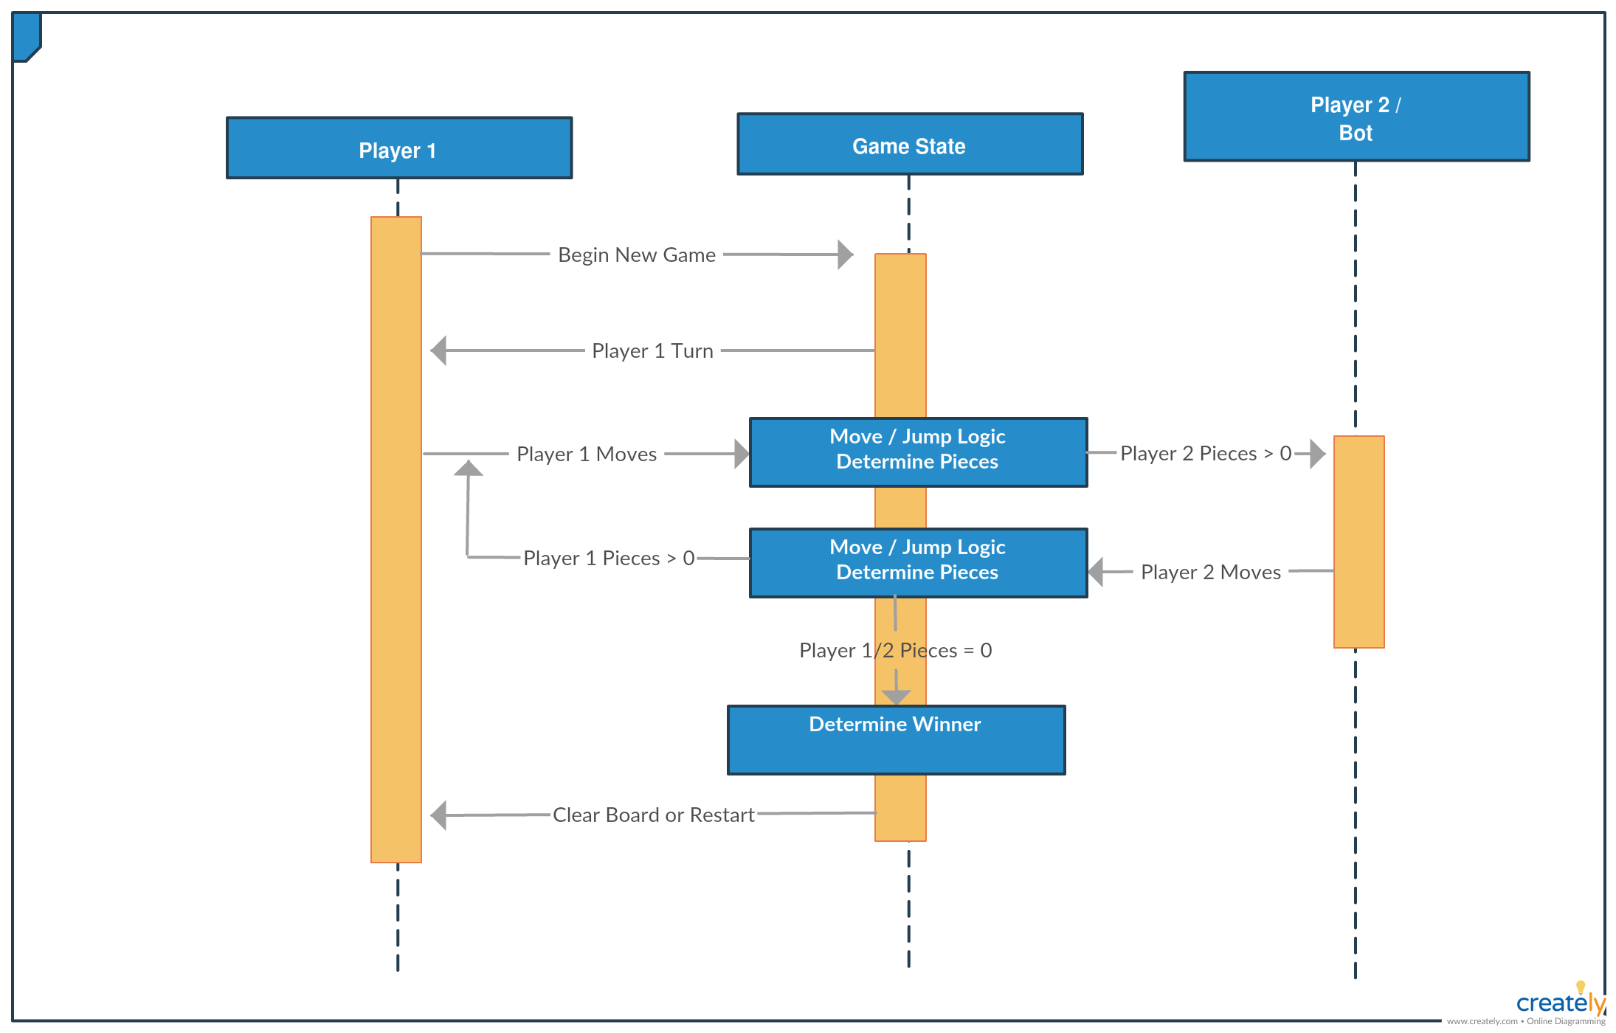
System Sequence Diagram

Slide 8
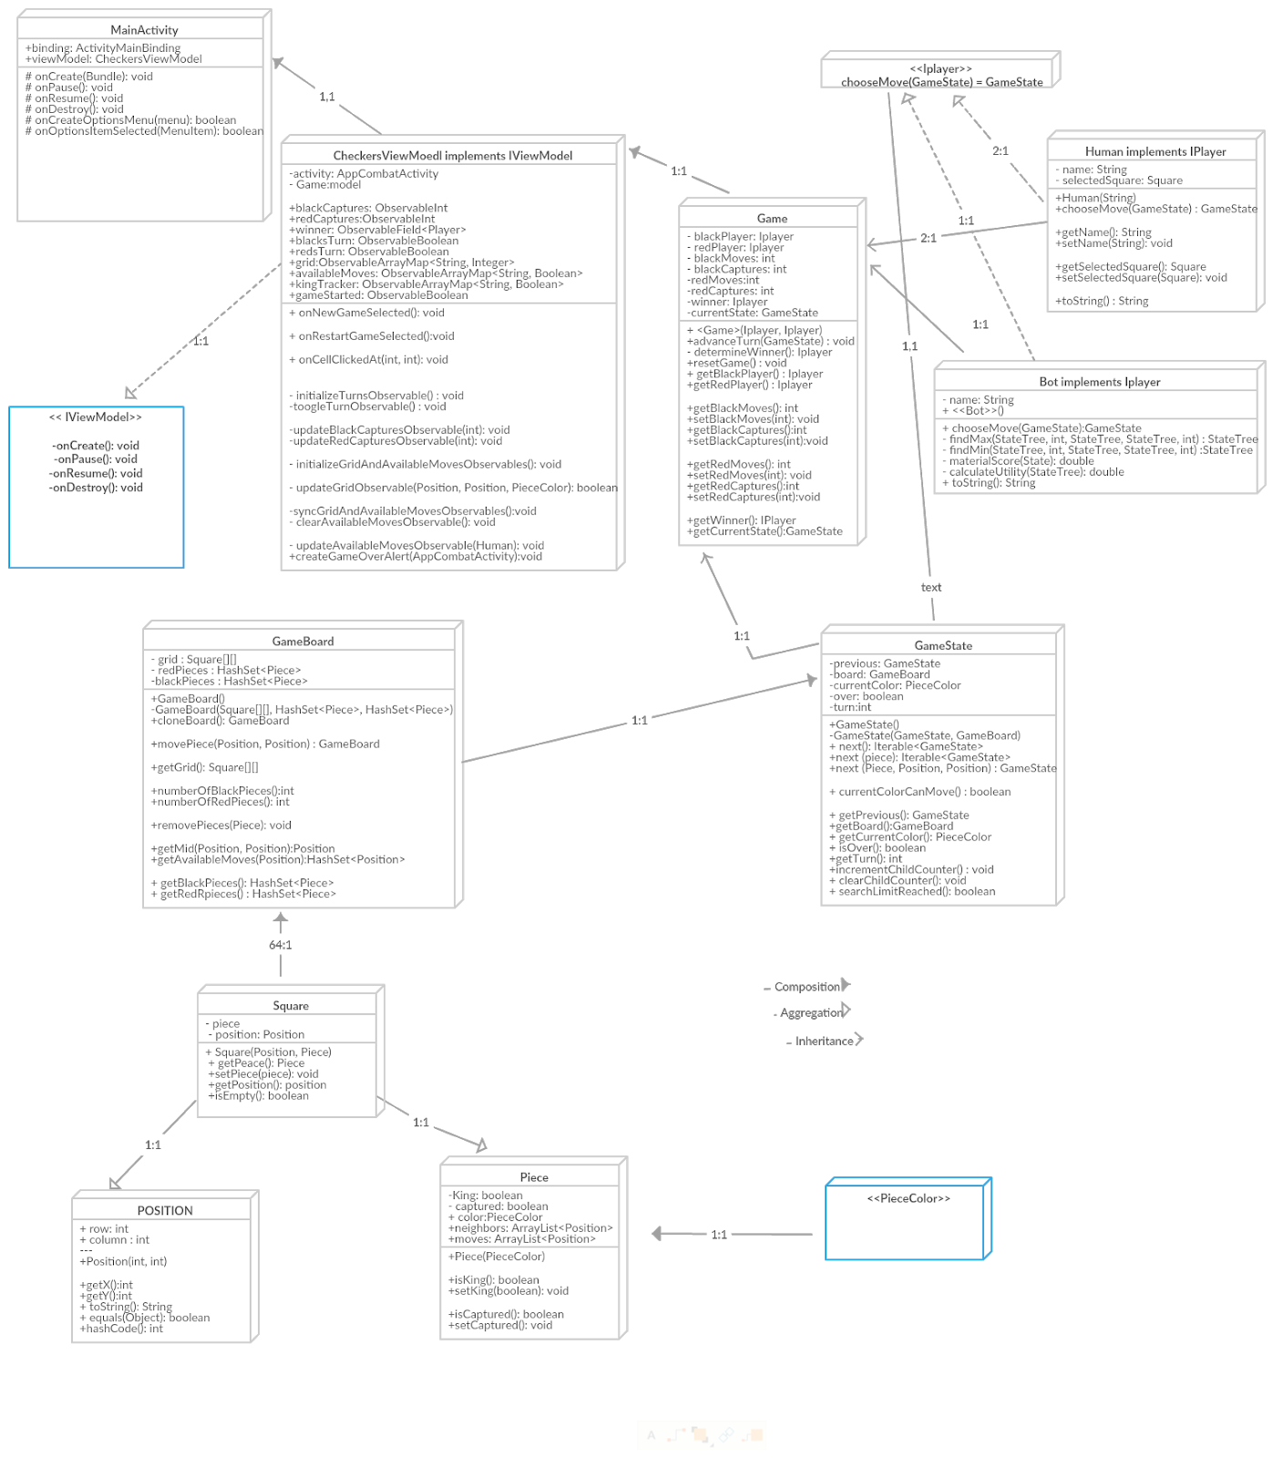
Design Diagram

Slide 9
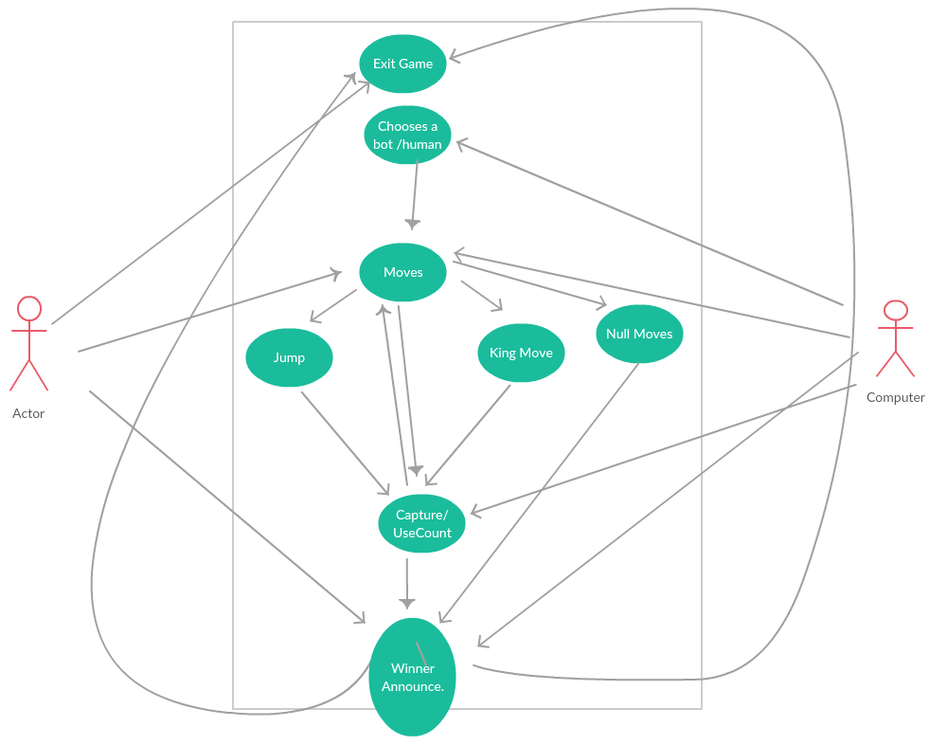
USE CASE Diagram
Notes:
Case Scenario:
The Actor(user) is presented the option of exiting the game or restarting the game or playing with a human or PC. The players (both human or human and a bot) make moves and capture. When no pieces are left in one of the player, the winner is announced and the board game is cleared.

Slide 10
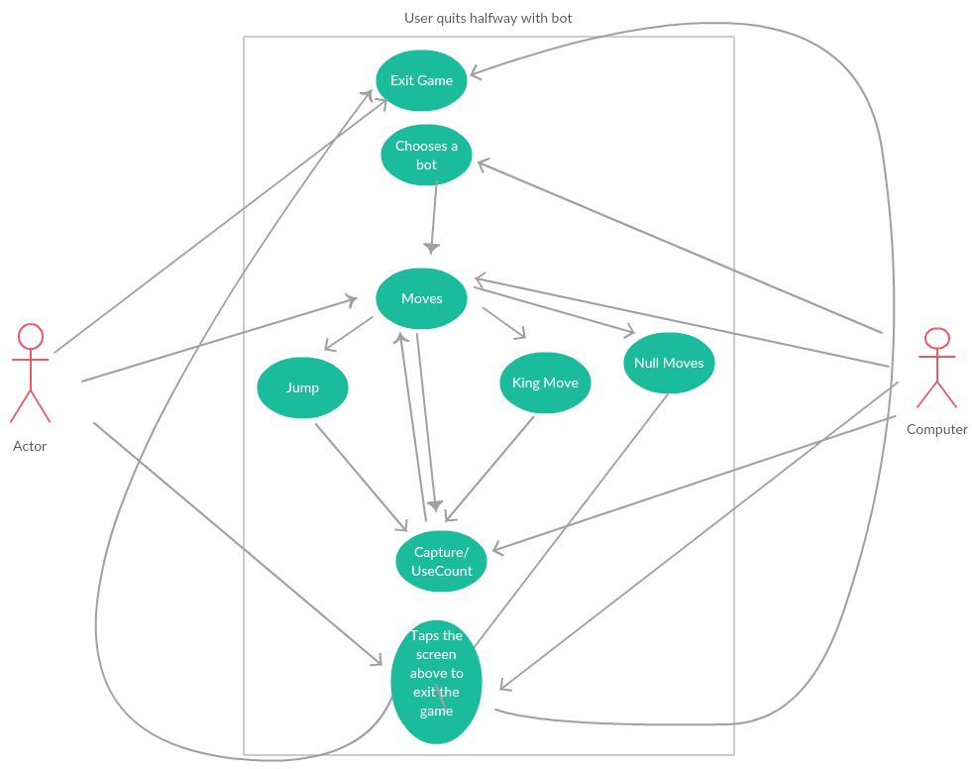
User QuitsHalfway
Notes:
With a above screen menu to stop the game midway, the user frustrated when he could not win against the bot, taps the button above to stop the game.

Slide 11
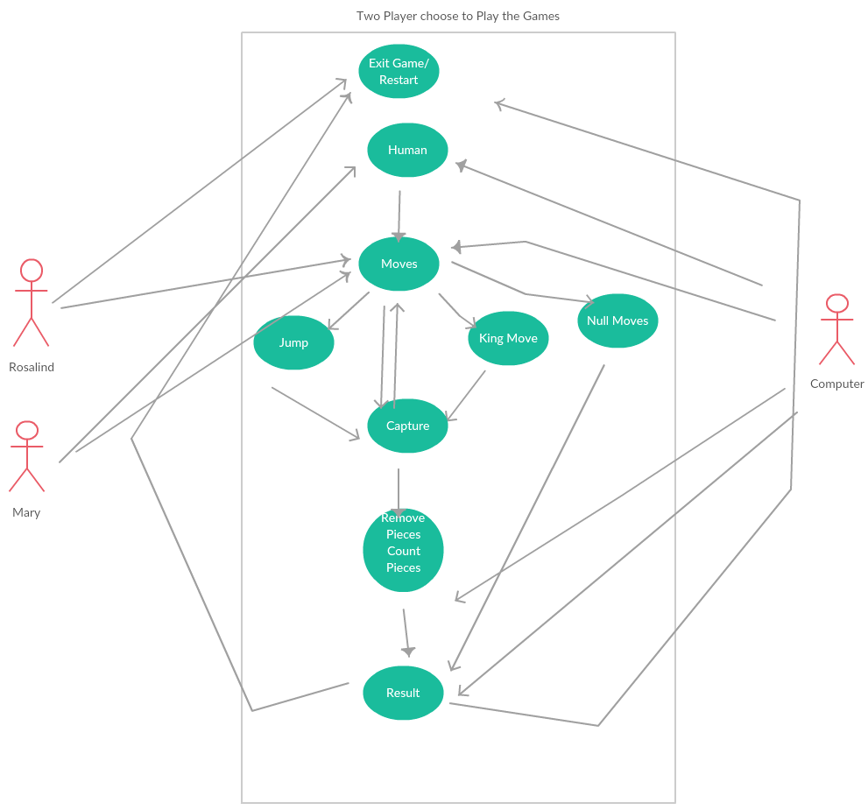
Two Users
Notes:
Rosalind and Mary choose to play the game against each other. They make moves as directed and as allowed by the game board.
After the result is announced, the screen is allowed to be cleared and the game restarts.

Slide 12
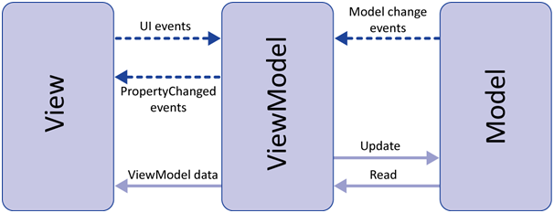
Model-View-ViewModel Design Pattern

Slide 13
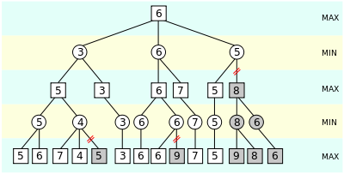
Checkerz Bot
Only contains one method
“chooseMove( )” Takes in the current state of the game and returns a child state that represents the state of the game after its move has been made
Explores up to 10,000 states per move
Uses Minimax Algorithm with Alpha-Beta pruning
It’s utility function uses a Material Score calculation

Slide 14
Repositories
Github:
https://github.com/CSCI4210/Checkerz
CircleCI:
https://circleci.com/dashboard
User Manual:
https://github.com/CSCI4210/Checkerz/blob/wsobol-patch-1/Checkerz%20User%20Manaul2.pdf

